Slide 1

Solving SQL Server DBA Problems with PowerShell
David Seis – DBA
Straight Path IT Solutions, LLC.

Slide 2




How can we handle the growth?

Slide 3

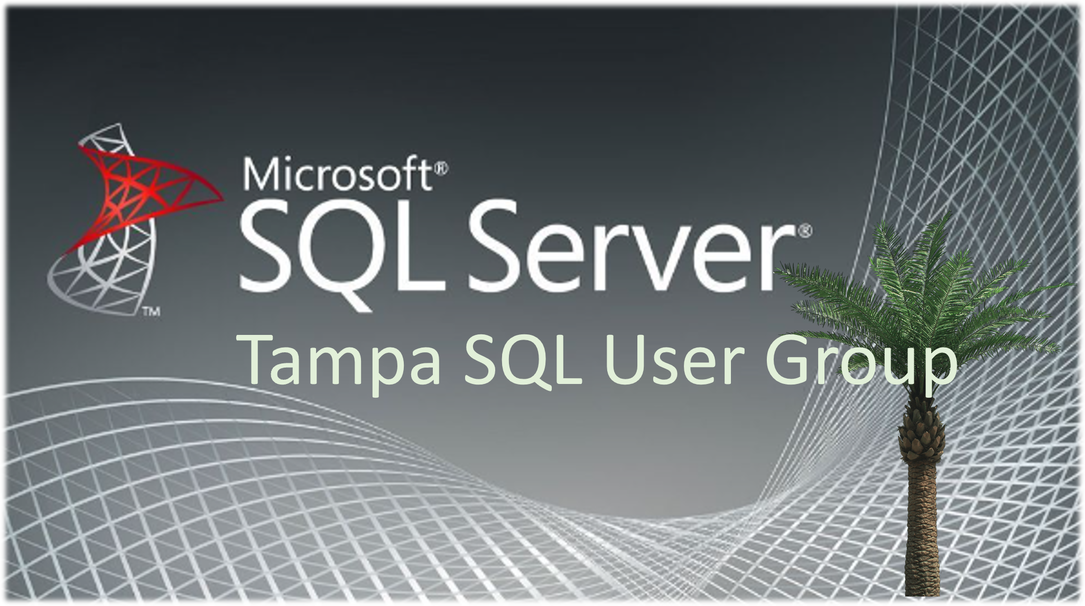


Introduction
DAVID
SEIS
Database Administrator
Leader
Aka.ms/TSUG

Slide 4
Presentation Overview
PowerShell Basics
Cmdlets, Variables, Objects, and Modules
Basic Automation
Single-Step processes such as making a one-time change or rolling out a simple maintenance configuration.
Advanced Automation
Multi-step processes where files are created and task scheduler integration is used such as monthly, daily, or weekly reports.

Slide 5


PowerShell basics

Slide 6
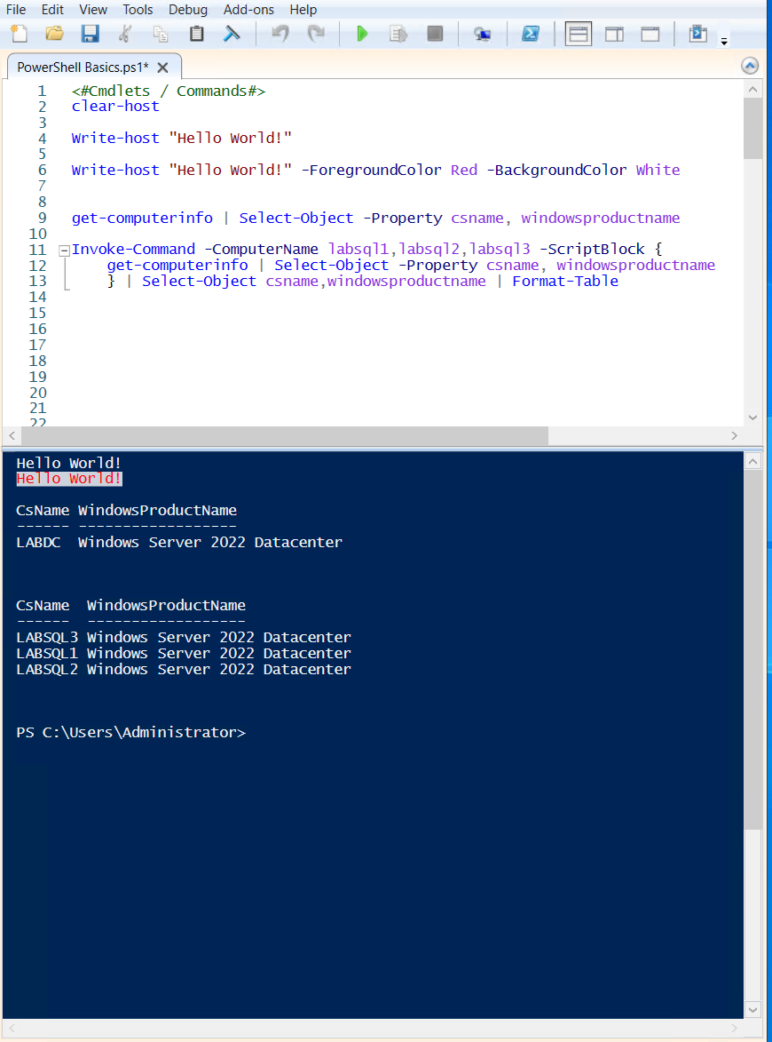

Cmdlets or Commands
Built in or module-based command scripts that have defined purpose and arguments.
Piping “ | ” is a way to pass the results or a variable into another command.

Slide 7
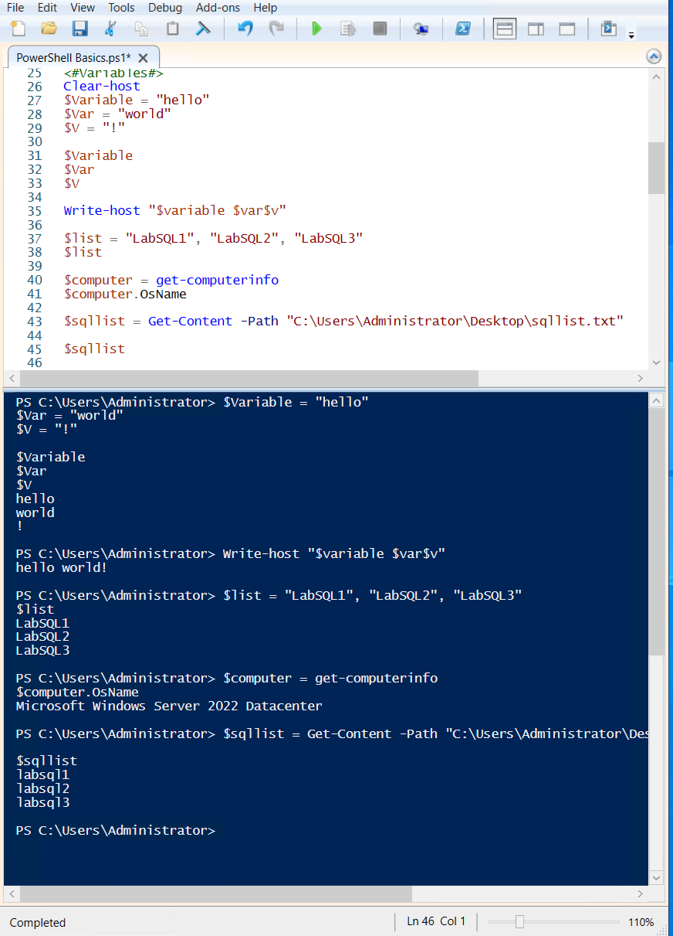
Variables
$-defined
Can be manually assigned, store the results of commands, and be reassigned in the same script.
SQL
PowerShell
Both
Can hold strings, arrays, or objects
Needs declaration
Session state only
Variables

Slide 8
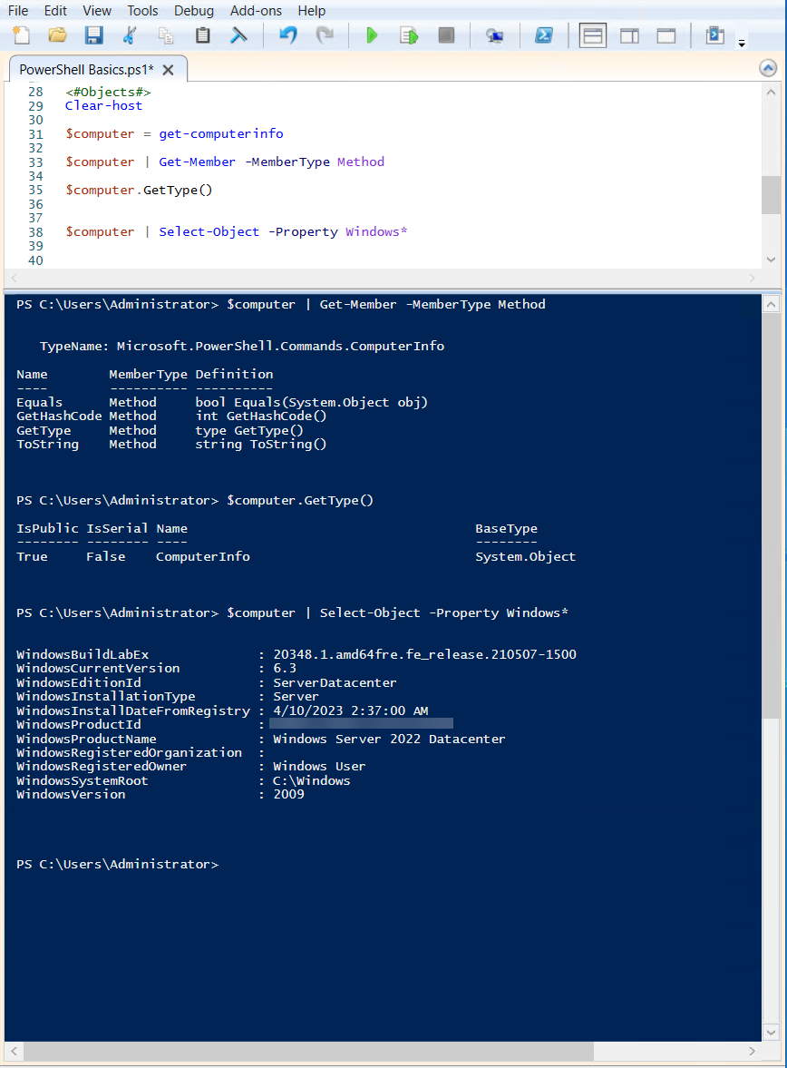
Objects
PowerShell is an object-oriented language. SQL is Declarative
Every object has a type, methods, and properties.

Slide 9
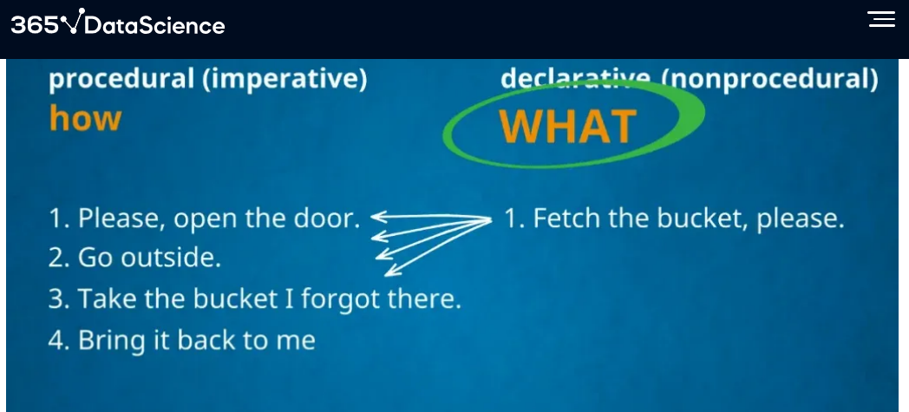
Objects

Slide 10
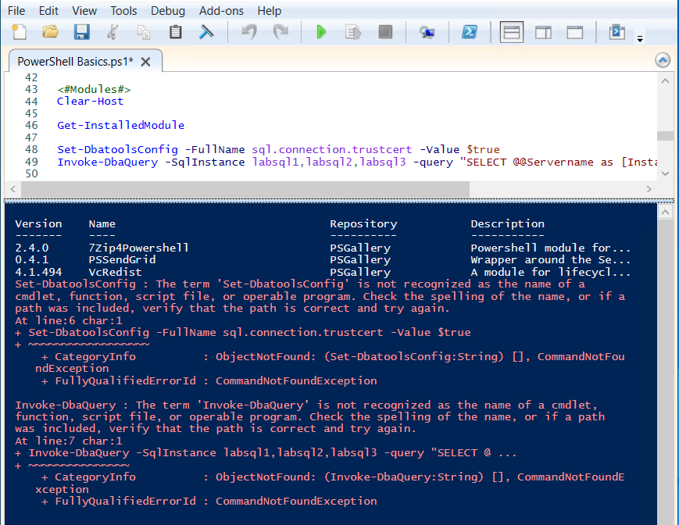
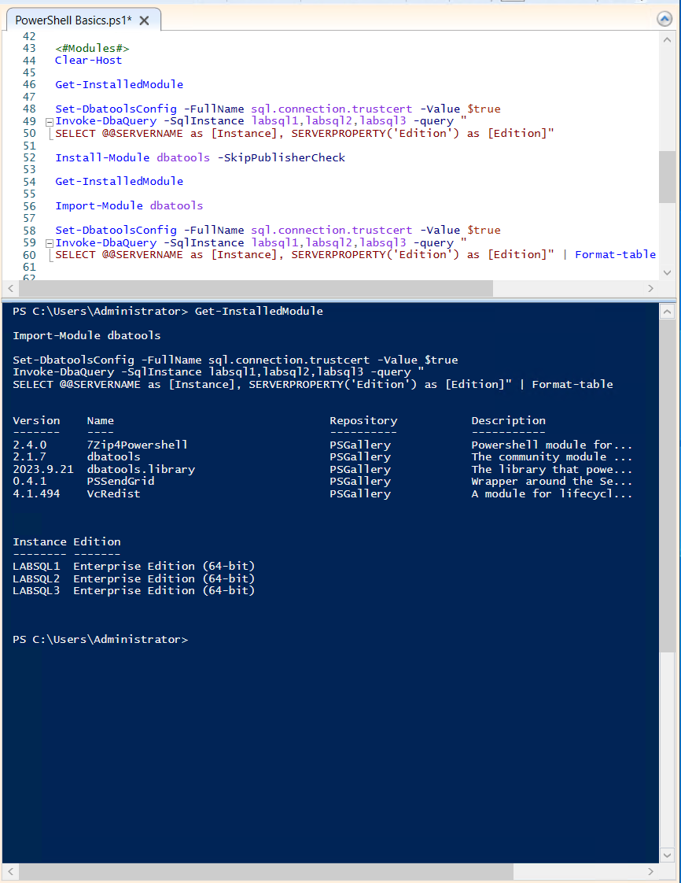
Modules
Pre-packaged cmdlets (commands) and much more.
Can get most from the PSGallery, others you can download or create yourself.
The most important for DBAs to know is DBAtools!

Slide 11
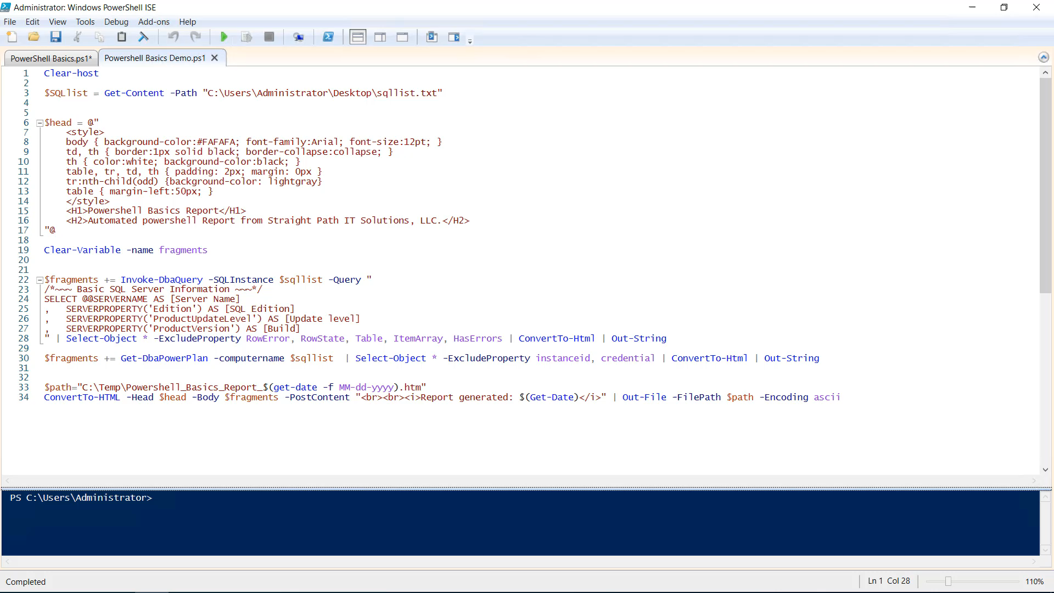
Demo
Calling a list from a file, querying the Instance and host, saving it as an html output.
But first, any questions?

Slide 12


Basic PowerShell Automation

Slide 13
Single step automation
Making life easier by reducing errors, speeding up repetitive tasks, and simplifying others.
Deploying maintenance
Fixing Jobs
Adding schedules
Simple reports
Adjusting configurations

Slide 14

Demo – Single step Automations
Deploying maintenance
Fixing Jobs
Adding schedules
Simple reports
Adjusting configurations

Slide 15
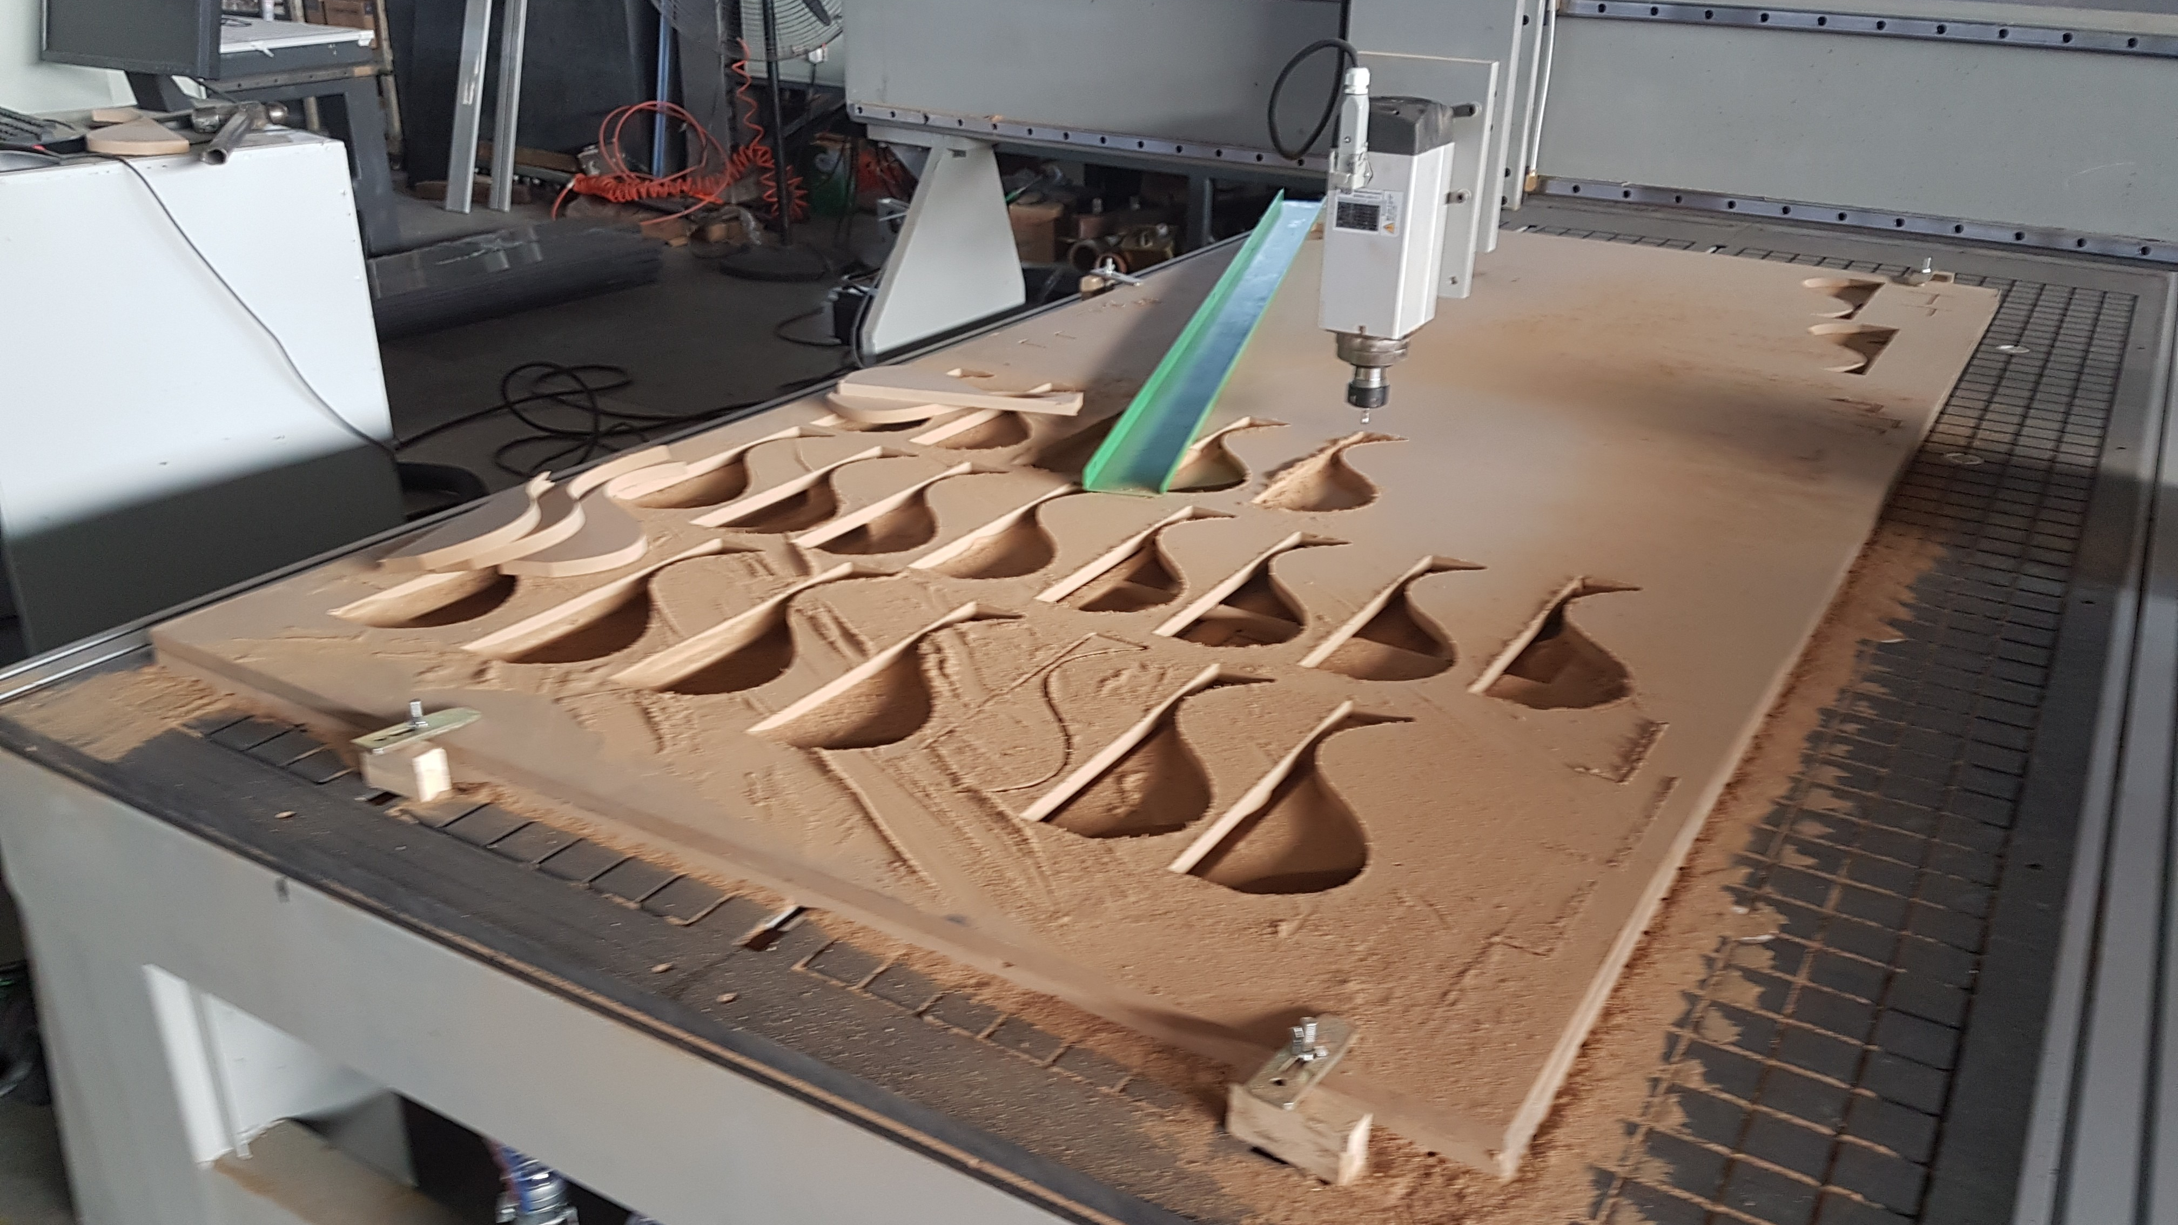

Advanced PowerShell Automation

Slide 16
Muli-step automation
Making life easier by building complex reporting tools to help manage your environment.
Login reports
Tooling versions
Job failures
Monthly Action items
Runbooks

Slide 17
Demo Muli-step automations
Login reports
Tooling versions
Job failures
Monthly Action items
Runbooks

Slide 18

Other considerations
Security /Certificates
File management

Slide 19
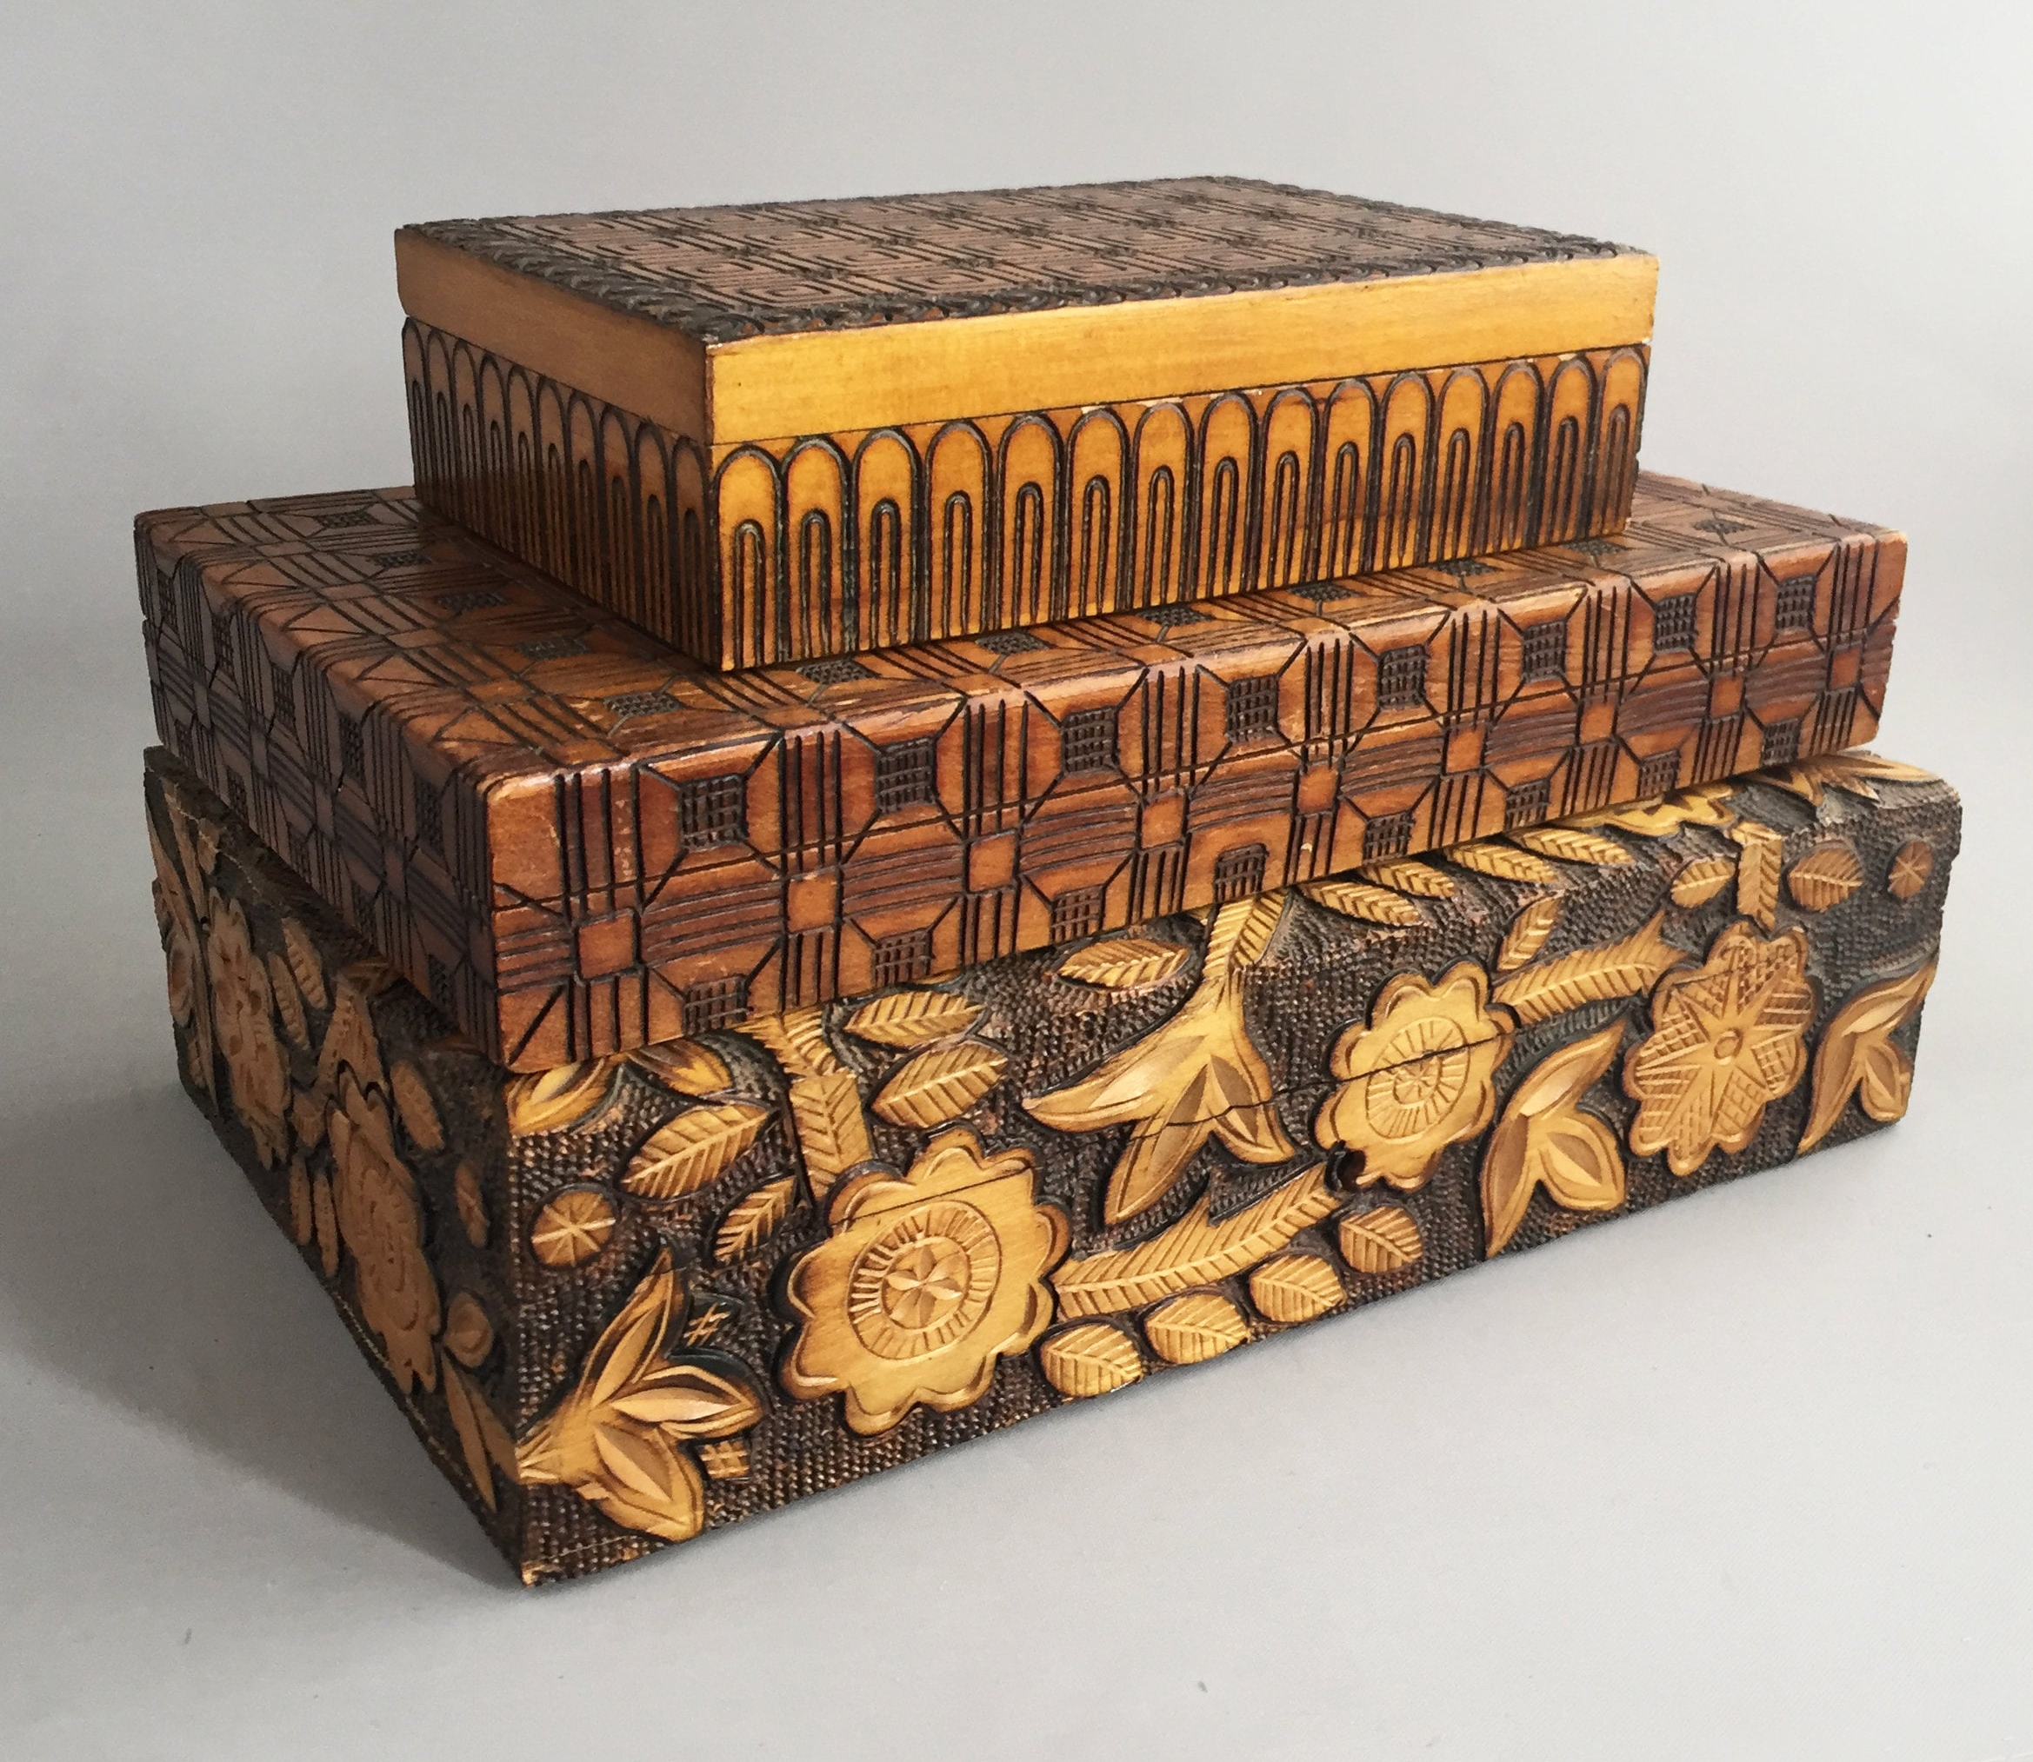
THANK YOU!

